Slide 1

Deep Learning:
Image Classification using CNN and Transfer Learning
PRESENTED BY: AYSE K., NEKKY L., RAÍSSA F.

Slide 2

Overview
1
Data Preprocessing
2
CNN Model 1
3
CNN Model 2
4
MobileNetV2
5
VGG16
6
EfficientNetB0
7
CNN X Transfer Learning

Slide 3
Data Preprocessing
Validate Data Structure
Confirm shape (-1,32,32,3) ensuring RGB format
Check Class Balance
Verify equal distribution across all 10 classes
Normalize Pixel Values
Scale from [0,255] to [0,1] for better convergence
Apply Data Augmentation
Use ImageDataGenerator for rotation, zoom, flip operations
CIFAR-10:
A BENCHMARK DATASET CONTAINING 60,000 32×32 COLOR IMAGES ACROSS 10 CLASSES (6,000 IMAGES PER CLASS)

Slide 4
Block | Description | Layers Included | Output Shape
1 | Conv Block 1 | Conv2D (32, ReLU) → BatchNorm → MaxPooling | (16, 16, 32)
2 | Conv Block 2 | Conv2D (64, ReLU) → BatchNorm → MaxPooling | (8, 8, 64)
3 | Conv Block 3 | Conv2D (128, ReLU) → BatchNorm → MaxPooling | (4, 4, 128)
4 | Flatten & Regularization | Flatten → Dropout (0.5) | 2048
5 | Fully Connected | Dense (256, ReLU) → Dropout (0.5) | 256
6 | Output Layer | Dense (10, Softmax) | 10 (class scores)
CNN
Model 1
OPTIMIZER:
ADAM
loss:
SPARSE_CATEGORICAL_CROSSENTROPY
CALLBACK
EARLY_STOPPING

Slide 5
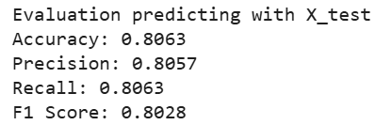
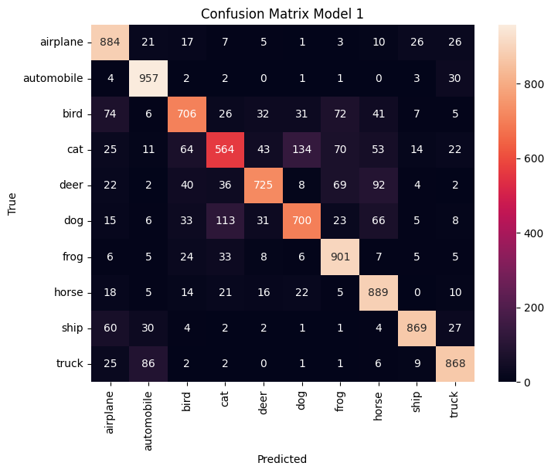
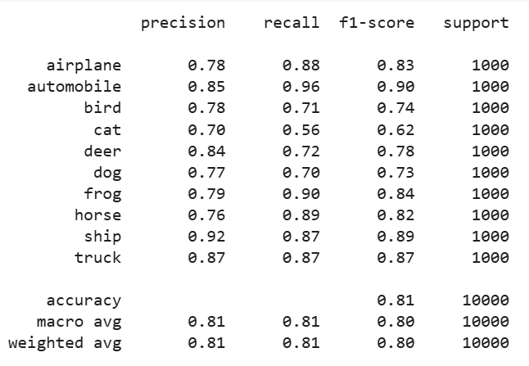
Evaluation
Model 1

Slide 6
Block | Description | Layers Included | Output Shape
1 | Conv Block 1 | Conv2D (32, ReLU,L2) → BatchNorm → MaxPooling | (16, 16, 32)
2 | Conv Block 2 | Conv2D (64, ReLU, L2) → BatchNorm → MaxPooling | (8, 8, 64)
3 | Conv Block 3 | Conv2D (128, ReLU, L2) → BatchNorm → MaxPooling | (4, 4, 128)
4 | Conv Block 4 | Conv2D (256, ReLU, L2) → BatchNorm → MaxPooling | (2,2,256)
5 | Global Feat. Extract | GlobalAveragePooling2D → Dropout (0.5) | 256
6 | Fully Connected | Dense (256, ReLU, L2) → Dropout (0.5) | 256
7 | Output Layer | Dense (10, Softmax) | 10 (class scores)
CNN
Model 2
OPTIMIZER:
ADAM
loss:
SPARSE_CATEGORICAL_CROSSENTROPY
CALLBACK
EARLY_STOPPING
REDUCELRONPLATEAU

Slide 7
Model 1 x Model 2
 | Model 1 | Model 2
Convolutional Blocks | 3 | 4
Regularization | Dropout | Dropout L2
Final Feature Layer | Flatten (2048) | GlobalAverage (256)
Callbacks | EarlyStopping | EarlyStopping ReduceLRO

Slide 8
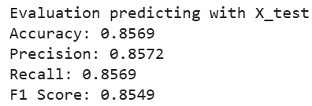
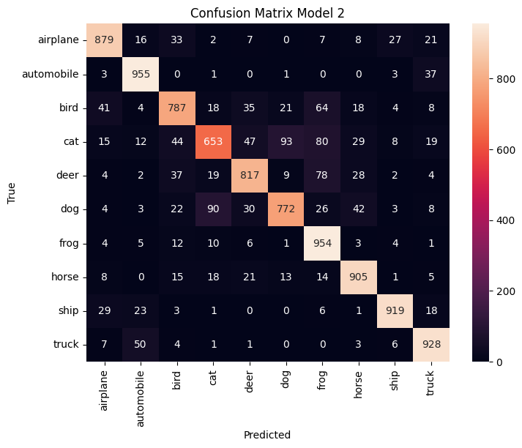
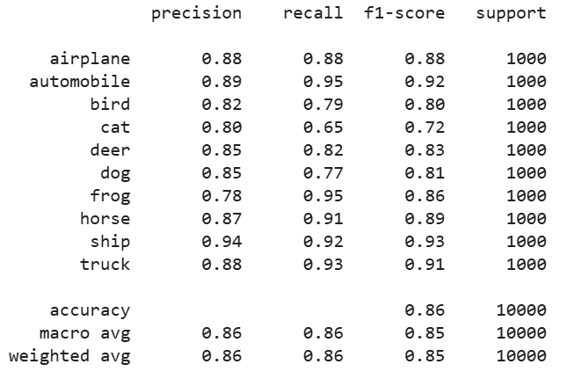
Evaluation
Model 2

Slide 9
Transfer Learning
MobileNetV2
VGG16
EfficientNetB0

Slide 10
MobileNetV2
ARCHITECTURE SPECIFICATIONS:
53 LAYERS
(51 CONVOLUTIONAL + 2 FULLY CONNECTED)
DEPTHWISE SEPARABLE CONVOLUTIONS (3X3 + 1X1 POINTWISE)
GLOBAL AVERAGE POOLING FOR SPATIAL REDUCTION
RELU6 ACTIVATION FUNCTIONS

Slide 11
Fine Tune
Training Stage | Phase 1: Transfer Learning | Phase 2: Fine-tuning
MobileNetV2 Layers Status | All layers frozen | Layers after index 100 frozen (~20% of network)
Learning Rate | 1e- 3 (Adam) | 1e-5 (Reduced)
Training Epochs | Up to 20 Epochs | Additional 10 epochs
Objective | Learn CIFAR-10 classification | Adapt higher-level pretrained features
Expected imrpovement | Baseline performance | 3-5% Accuracy gain

Slide 12
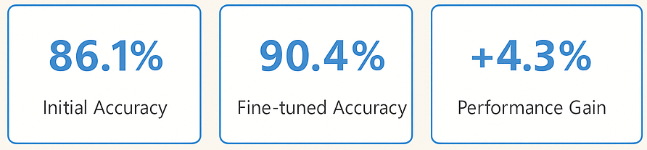
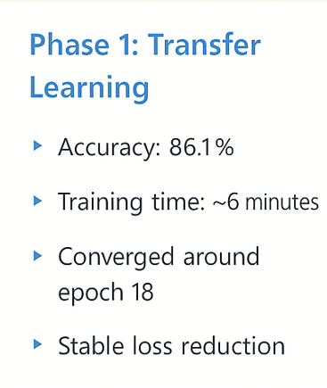
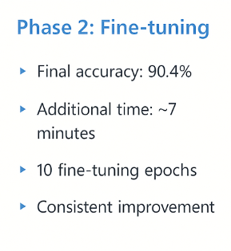
Metrics

Slide 13
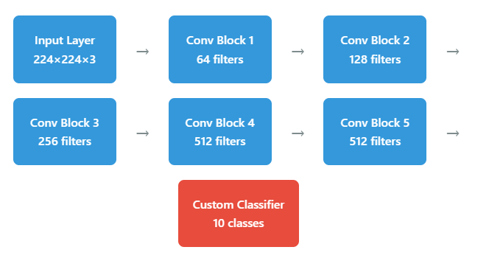
VGG16
ARCHITECTURE OVERVIEW
Architecture Specifications:
16 LAYERS
(13 CONVOLUTIONAL + 3 FULLY CONNECTED)
3×3 CONVOLUTION FILTERS THROUGHOUT
MAX POOLING FOR SPATIAL REDUCTION
RELU ACTIVATION FUNCTIONS

Slide 14
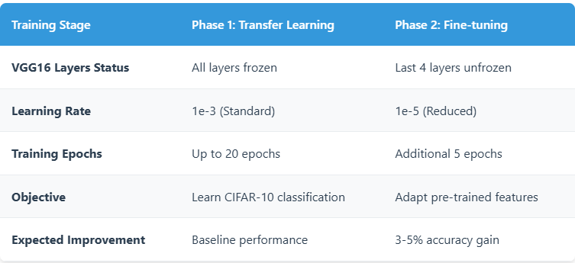
VGG16
Fine Tune

Slide 15
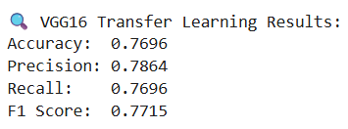
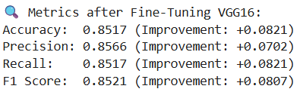
VGG16
Model Performance Metrics

Slide 16
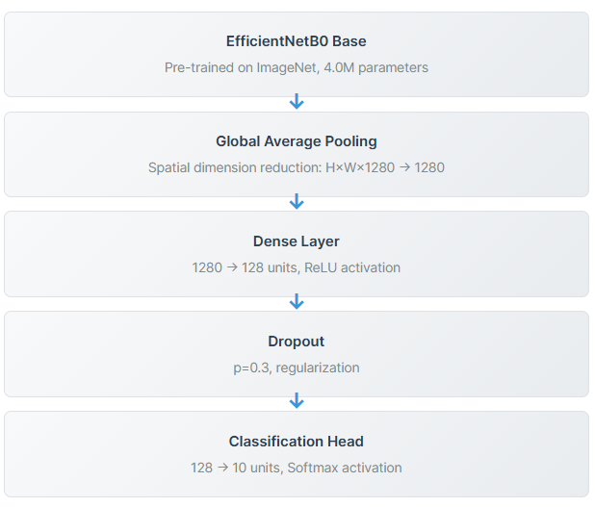
EfficientNetB0
ARCHITECTURE OVERVIEW

Slide 17
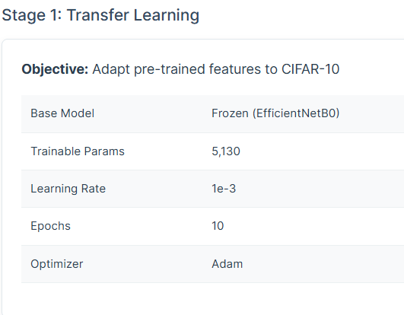
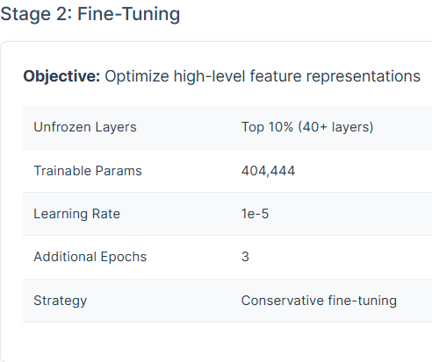
EfficientNetB0
Fine Tune

Slide 18
EfficientNetB0
Model Performance Metrics
Transfer Learning Results: |  | After fine tuning:
Accuracy 83.10% |  | Accuracy 83.5%
Precision 83.18% |  | Precision 84.2%
Recall 83.10% |  | Recall 85.4%
F1-SCORE 83.11% |  | F1-SCORE 84.7%

Slide 19
Transfer Learning X CNN
CONVOLUTIONAL NEURAL NETWORKS:
LEARN LOW-LEVEL → HIGH-LEVEL IMAGE FEATURES
REQUIRE LARGE DATASETS + LONG TRAINING TIME
TRANSFER LEARNING:
USES A PRETRAINED CNN
LEVERAGES KNOWLEDGE FROM IMAGENET
ONLY RETRAINS TOP ALYERS OR FINE-TUNES LAST’ BLOCKS
OUR RESULTS:
CUSTOM CNNS ACHIEVED ~70-80% ACCURACY
TRANSFER LEARNING BOOSETED TO ~85-90%+ ACCURACY
FINE-TUNING ADDED AN EXTRA 3-5% PERFORMANCE GAIN BEYOND BASELINE TRANSFER LEARNING
CNN FEATURE EXTRACTION + TRANSFER LEARNING → BEST BALANCE OF SPEED, ACCURACY AND GENERALIZATION

Slide 20
Thank you

